Slide 1
A wearable medical assistant

Slide 2
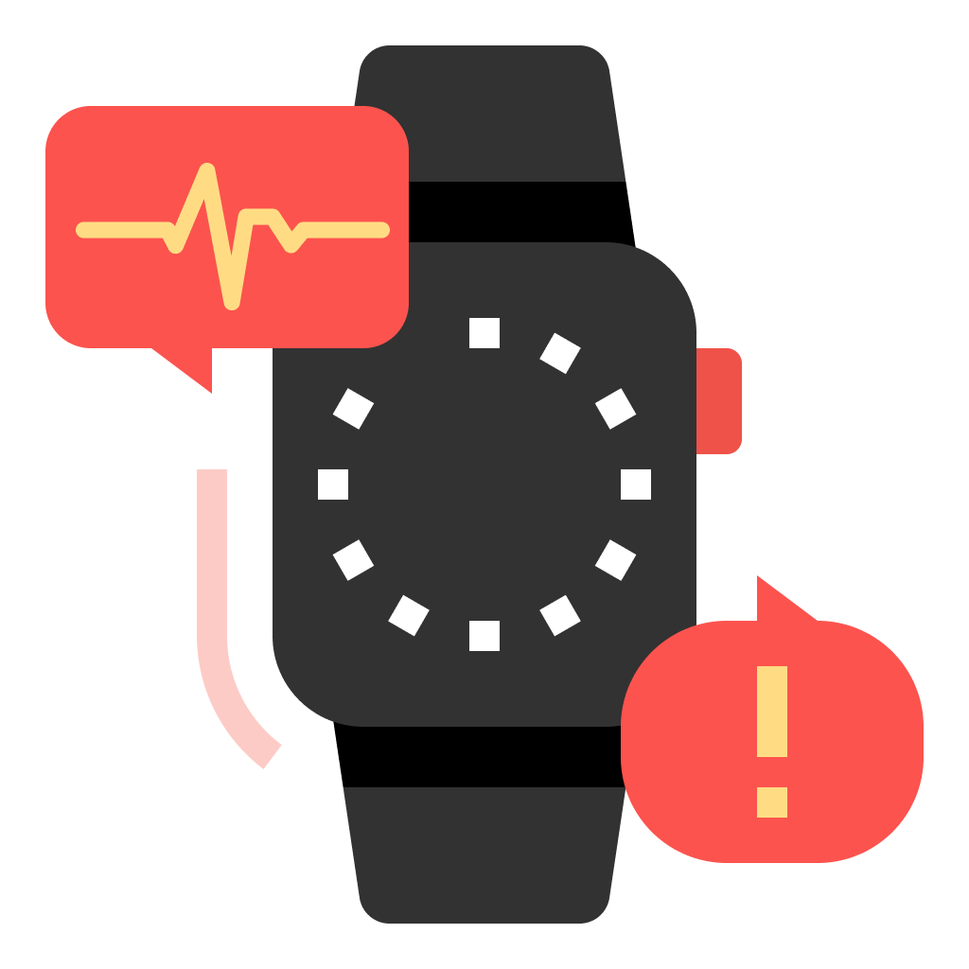
Hello!
I ‘m liv,
I am here to help you during a medical emergency.

Slide 3
Why liv?

Slide 4
Why?
Currently, the process of seeking emergency care is difficult, especially if the person seeking help is incapacitated or at risk of a medical condition or failure.
Products like LifeAlert are only directed towards a specific audience and have limited features to actually be successful.

Slide 5
Liv is for anyone who is at risk of a medical emergency. This can be an elderly person who has Parkinson’s, and adult with diabetes, or a young child with a serious allergy.

Slide 6
How liv works

Slide 7
How liv works
Wearers create a user profile on the website.
When an emergency occurs, the information of the user in need of help is sent to the nearest hospital which is then passed to the emergency responders.
A sound emits from the device, and their approved users are alerted by Liv as well.

Slide 8
How liv works
Liv is able to provide information to emergency responders when the patient is incapacitated and unable to answer questions or provide information.
Liv minimizes the time it takes to help a patient, saving lives.

Slide 9
Major Features

Slide 10
Information Storing and Alerts
Liv stores pertinent medical information of the user in a unique user profile and sends it via SMS.

Slide 11
GPS Tracking
Liv is able to track the wearer in real time and send the location when necessary.

Slide 12
Website

Slide 13
Demo
Notes:
https://photos.app.goo.gl/Z1v3wJ8WPR3kSeMR9

